Slide 1
ASTRONOMY I
Chapter 4
EARTH, MOON, AND SKY

Slide 2
Chapter 4
EARTH, MOON, AND SKY
4.1 Earth and Sky
4.2 The Seasons
4.3 Keeping Time
4.4 The Calendar
4.5 Phases and Motions of the Moon
4.6 Ocean Tides and the Moon
4.7 Eclipses of the Sun and Moon
By the end of these sections, you will be able to:
Describe how latitude and longitude are used to map Earth
Explain how right ascension and declination are used to map the sky
Describe how the tilt of Earth’s axis causes the seasons
Explain how seasonal differences on Earth vary with latitude

Slide 3
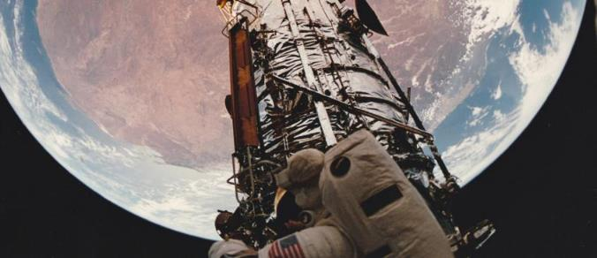
Opening Questions…
If Earth’s orbit is nearly a perfect circle (as we saw in earlier chapters), why is it hotter in summer and colder in winter in many places around the globe?
And why are the seasons in Australia or Peru the opposite of those in the United States or Europe?
It is the motions of Earth that produce the seasons and give us our measures of time and date.
The Moon’s motions around us provide the concept of the month and the cycle of lunar phases.
In this chapter we examine some of the basic phenomena of our everyday world in their astronomical context.
Southern Summer As captured with a fish-eye lens aboard the Atlantis Space Shuttle on December 9, 1993, Earth hangs above the Hubble Space Telescope as it is repaired. The reddish continent is Australia, its size and shape distorted by the special lens. Because the seasons in the Southern Hemisphere are opposite those in the Northern Hemisphere, it is summer in Australia on this December day. (credit: modification of work by NASA)

Slide 4
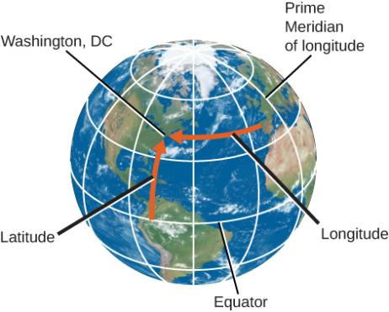
Earth and Sky
In order to uniquely and simply identify the location on Earth, we divide the surface of Earth into a grid, and each location on that grid can easily be found using its latitude and longitude coordinate.
Astronomers have a similar system for objects on the sky. Learning about these can help us understand the apparent motion of objects in the sky from various places on Earth.
Earth’s axis of rotation defines the locations of its North and South Poles and of its equator, halfway between. Two other directions are also defined by Earth’s motions: east is the direction toward which Earth rotates, and west is its opposite.
A great circle is any circle on the surface of a sphere whose center is at the center of the sphere (Equator).
Great circles that pass through both the North and South Poles are called Meridian.
Latitude and Longitude of Washington DC We use latitude and longitude to find cities on a globe. Latitude is the number of degrees north or south of the equator, and longitude is the number of degrees east or west of the Prime Meridian. Washington, DC’s coordinates are 38° N and 77° W.

Slide 5
Earth and Sky
Any point on the surface of Earth has a meridian passing through it.
The meridian specifies the east-west location, or longitude, of the place. By international agreement (and it took many meetings for the world’s countries to agree, 1884 AD), longitude is defined as the number of degrees of arc along the equator between your meridian and the one passing through Greenwich, England, which has been designated as the Prime Meridian.
The longitude of the Prime Meridian is defined as 0°.
Longitudes are measured either to the east or to the west of the Greenwich meridian from 0° to 180°.
Latitudes are measured either north or south of the equator from 0° to 90° (The latitude of the equator is 0°).
Latitude and Longitude of Washington DC We use latitude and longitude to find cities like Washington, DC, on a globe. Latitude is the number of degrees north or south of the equator, and longitude is the number of degrees east or west of the Prime Meridian. Washington, DC’s coordinates are 38° N and 77° W.

Slide 6
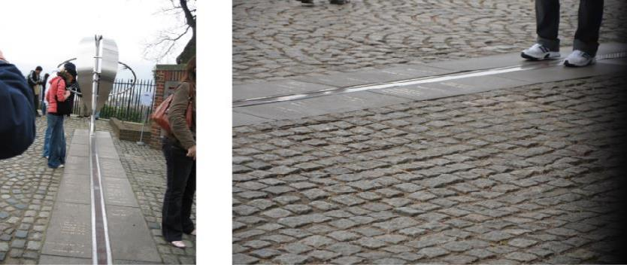
Royal Observatory in Greenwich, England. At the internationally agreed-upon zero point of longitude at the Royal Observatory Greenwich, tourists can stand and straddle the exact line where longitude “begins.” (credit left: modification of work by “pdbreen”/Flickr; credit right: modification of work by Ben Sutherland)

Slide 7
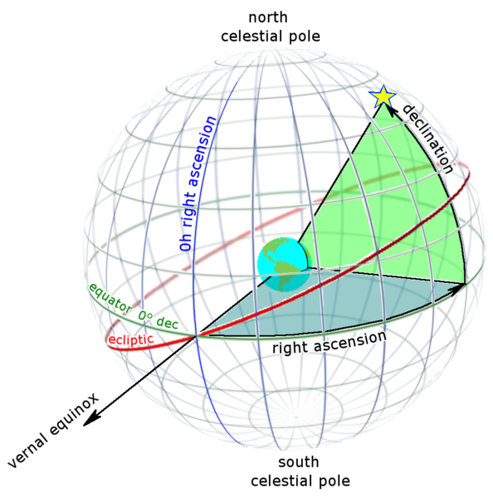
Earth and Sky Locating Places in the Sky
Positions in the sky are measured in a way that is very similar to the way we measure positions on the surface of Earth.
Astronomers use coordinates called Declination and Right Ascension.
Declination on the celestial sphere is measured from the celestial equator toward the north (positive) or south (negative). Polaris has a declination of almost +90°.
Vernal Equinox, a point in the sky where the ecliptic (the Sun’s path) crosses the celestial equator.
Right ascension (RA) is measured from Vernal Equinox in the units of degrees or hours.
Since it takes 24 hours to complete a rotation, 1 hour is equal to 15° arc. (24 hours = 360°)
Right Ascension and Declination as seen from outside the celestial sphere

Slide 8
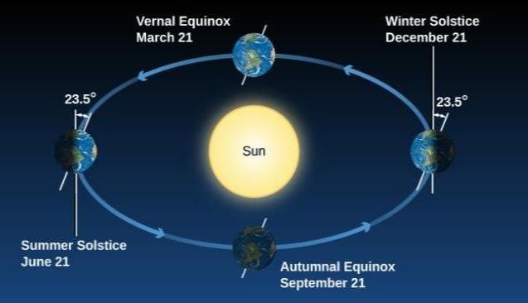
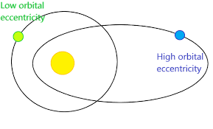
The seasons
Although Earth’s orbit around the Sun is an ellipse, its distance from the Sun varies by only about 3%. That’s not enough to cause significant variations in the Sun’s heating.
The seasons are caused by the 23.5° tilt of Earth’s axis, and its revolution.
In June the Northern Hemisphere “leans into” the Sun and is more directly illuminated. In December, the situation is reversed: the Southern Hemisphere leans into the Sun, and the Northern Hemisphere leans away.
In September and March, Earth leans “sideways”—neither into the Sun nor away from it—so the two hemispheres are equally favored with sunshine.
Seasons. We see Earth at different seasons as it circles the Sun.

Slide 9
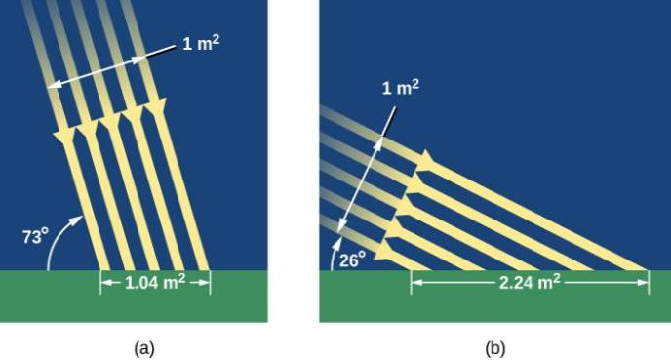
The seasons
How does the Sun’s favoring one hemisphere translate into making it warmer for us down on the surface of Earth?
Reason 1:
When we lean into the Sun, sunlight hits us at a more direct angle and is more effective at heating Earth’s surface
The sunlight in June is more direct and intense in the Northern Hemisphere, and hence more effective at heating.
The Sun’s Rays in Summer and Winter.
In summer, the Sun appears high in the sky and its rays hit Earth more directly, spreading out less.
In winter, the Sun is low in the sky and its rays spread out over a much wider area, becoming less effective at heating the ground.

Slide 10
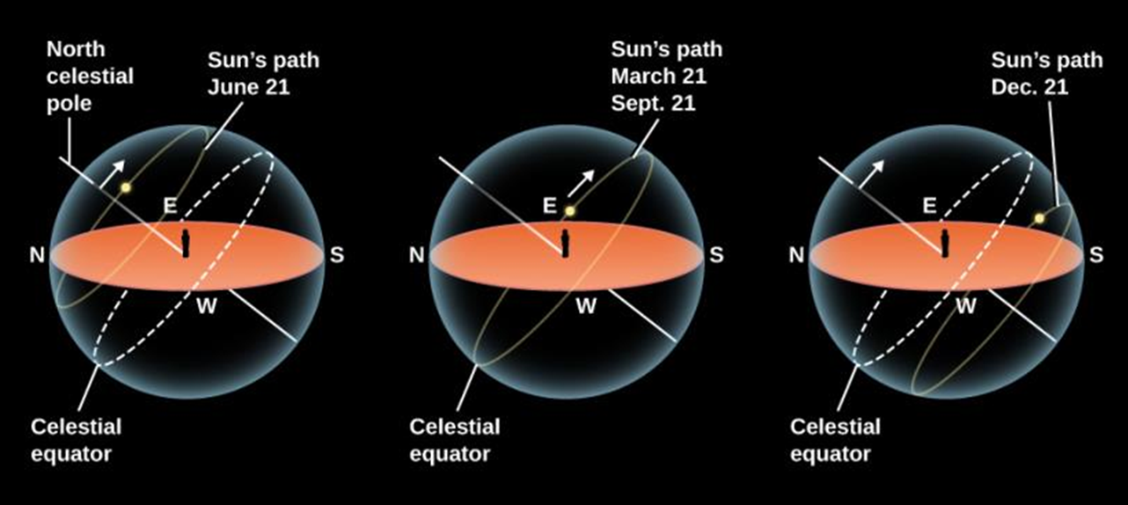
The seasons
How does the Sun’s favoring one hemisphere translate into making it warmer for us down on the surface of Earth?
Reason 2:
The length of time the Sun spends above the horizon is longer in Summer and shorter in Winter
In June, the Sun is north of the celestial equator and spends more time in the Northern Hemisphere.
It rises high in the sky and is above the horizon in the United States for as long as 15 hours. Thus, the Sun not only heats us with more direct rays, but it also has more time to do it each day.
The Sun’s Path in the Sky for Different Seasons.
On June 21, the Sun rises north of east and sets north of west. For observers in the Northern Hemisphere of Earth, the Sun spends about 15 hours above the horizon in the United States, meaning more hours of daylight. On December 21, the Sun rises south of east and sets south of west. It spends 9 hours above the horizon in the United States, which means fewer hours of daylight and more hours of night in northern lands. On March 21 and September 21, the Sun spends equal amounts of time above and below the horizon in both hemispheres.

Slide 11
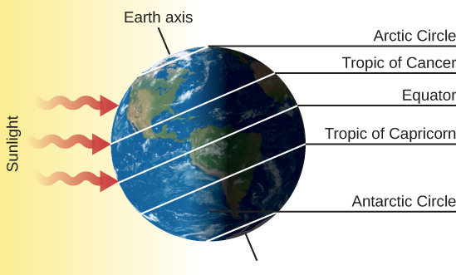
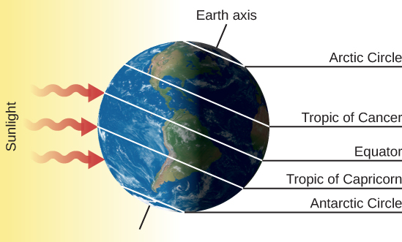
Sun’s illumination on earth
Earth on June 21. This is the date of the summer solstice in the Northern Hemisphere. As Earth turns on its axis (the line connecting the North and South Poles), the North Pole is in constant sunlight while the South Pole is veiled in 24 hours of darkness. The Sun is at the zenith for observers on the Tropic of Cancer (23° N)
Earth on December 21. This is the date of the winter solstice in the Northern Hemisphere. Now the North Pole is in darkness for 24 hours and the South Pole is illuminated. The Sun is at the zenith for observers on the Tropic of Capricorn (23° S) and thus is low in the sky for the residents of the Northern Hemisphere.

Slide 12
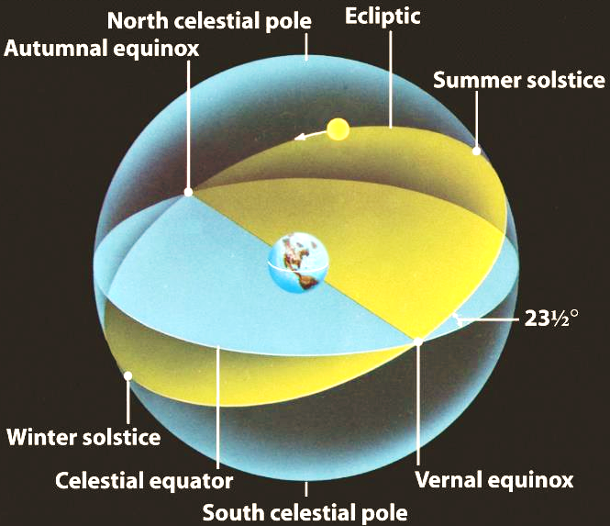
equinox
Summer Solstice: June 21
Winter Solstice: Dec 21
Vernal Equinox: March 21
Autumnal Equinox: September 21
The ecliptic and the celestial equator intersect at two points called the equinoxes.
The northernmost point on the ecliptic is called the summer solstice; the southernmost point is called the winter solstice.

Slide 13
Chapter 4
EARTH, MOON, AND SKY
4.1 Earth and Sky
4.2 The Seasons
4.3 Keeping Time
4.4 The Calendar
4.5 Phases and Motions of the Moon
4.6 Ocean Tides and the Moon
4.7 Eclipses of the Sun and Moon
By the end of these sections, you will be able to:
Explain the difference between the solar day and the sidereal day
Explain mean solar time and the reason for time zones
Understand how calendars varied among different cultures
Explain the origins of our modern calendar

Slide 14
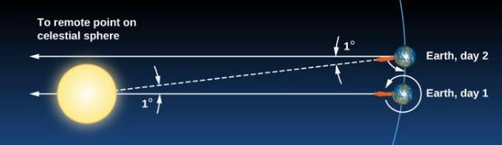
Keeping time
The measurement of time is based on the rotation of Earth. Throughout most of human history, time has been reckoned by positions of the Sun and stars in the sky. Only recently have mechanical and electronic clocks taken over this function in regulating our lives.
Difference Between a Sidereal Day and a Solar Day. This is a top view, looking down as Earth orbits the Sun. Because Earth moves around the Sun (roughly 1° per day), after one complete rotation of Earth relative to the stars, we do not see the Sun in the same position.
The Length of the Day
The most fundamental astronomical unit of time is the day, measured in terms of the rotation of Earth.
There is, however, more than one way to define the day.
Solar Day: The rotation period of Earth with respect to the Sun.
Sidereal Day: The rotation period of Earth with respect to the stars.
Because of the movement of Earth along its orbit from day 1 to 2, the Sun has not yet reached a position above the observer. To complete a solar day, Earth must rotate an additional amount, equal to 1/365 of a full turn. The time required for this extra rotation is 1/365 of a day, or about 4 minutes. So, the solar day is about 4 minutes longer than the sidereal day.

Slide 15
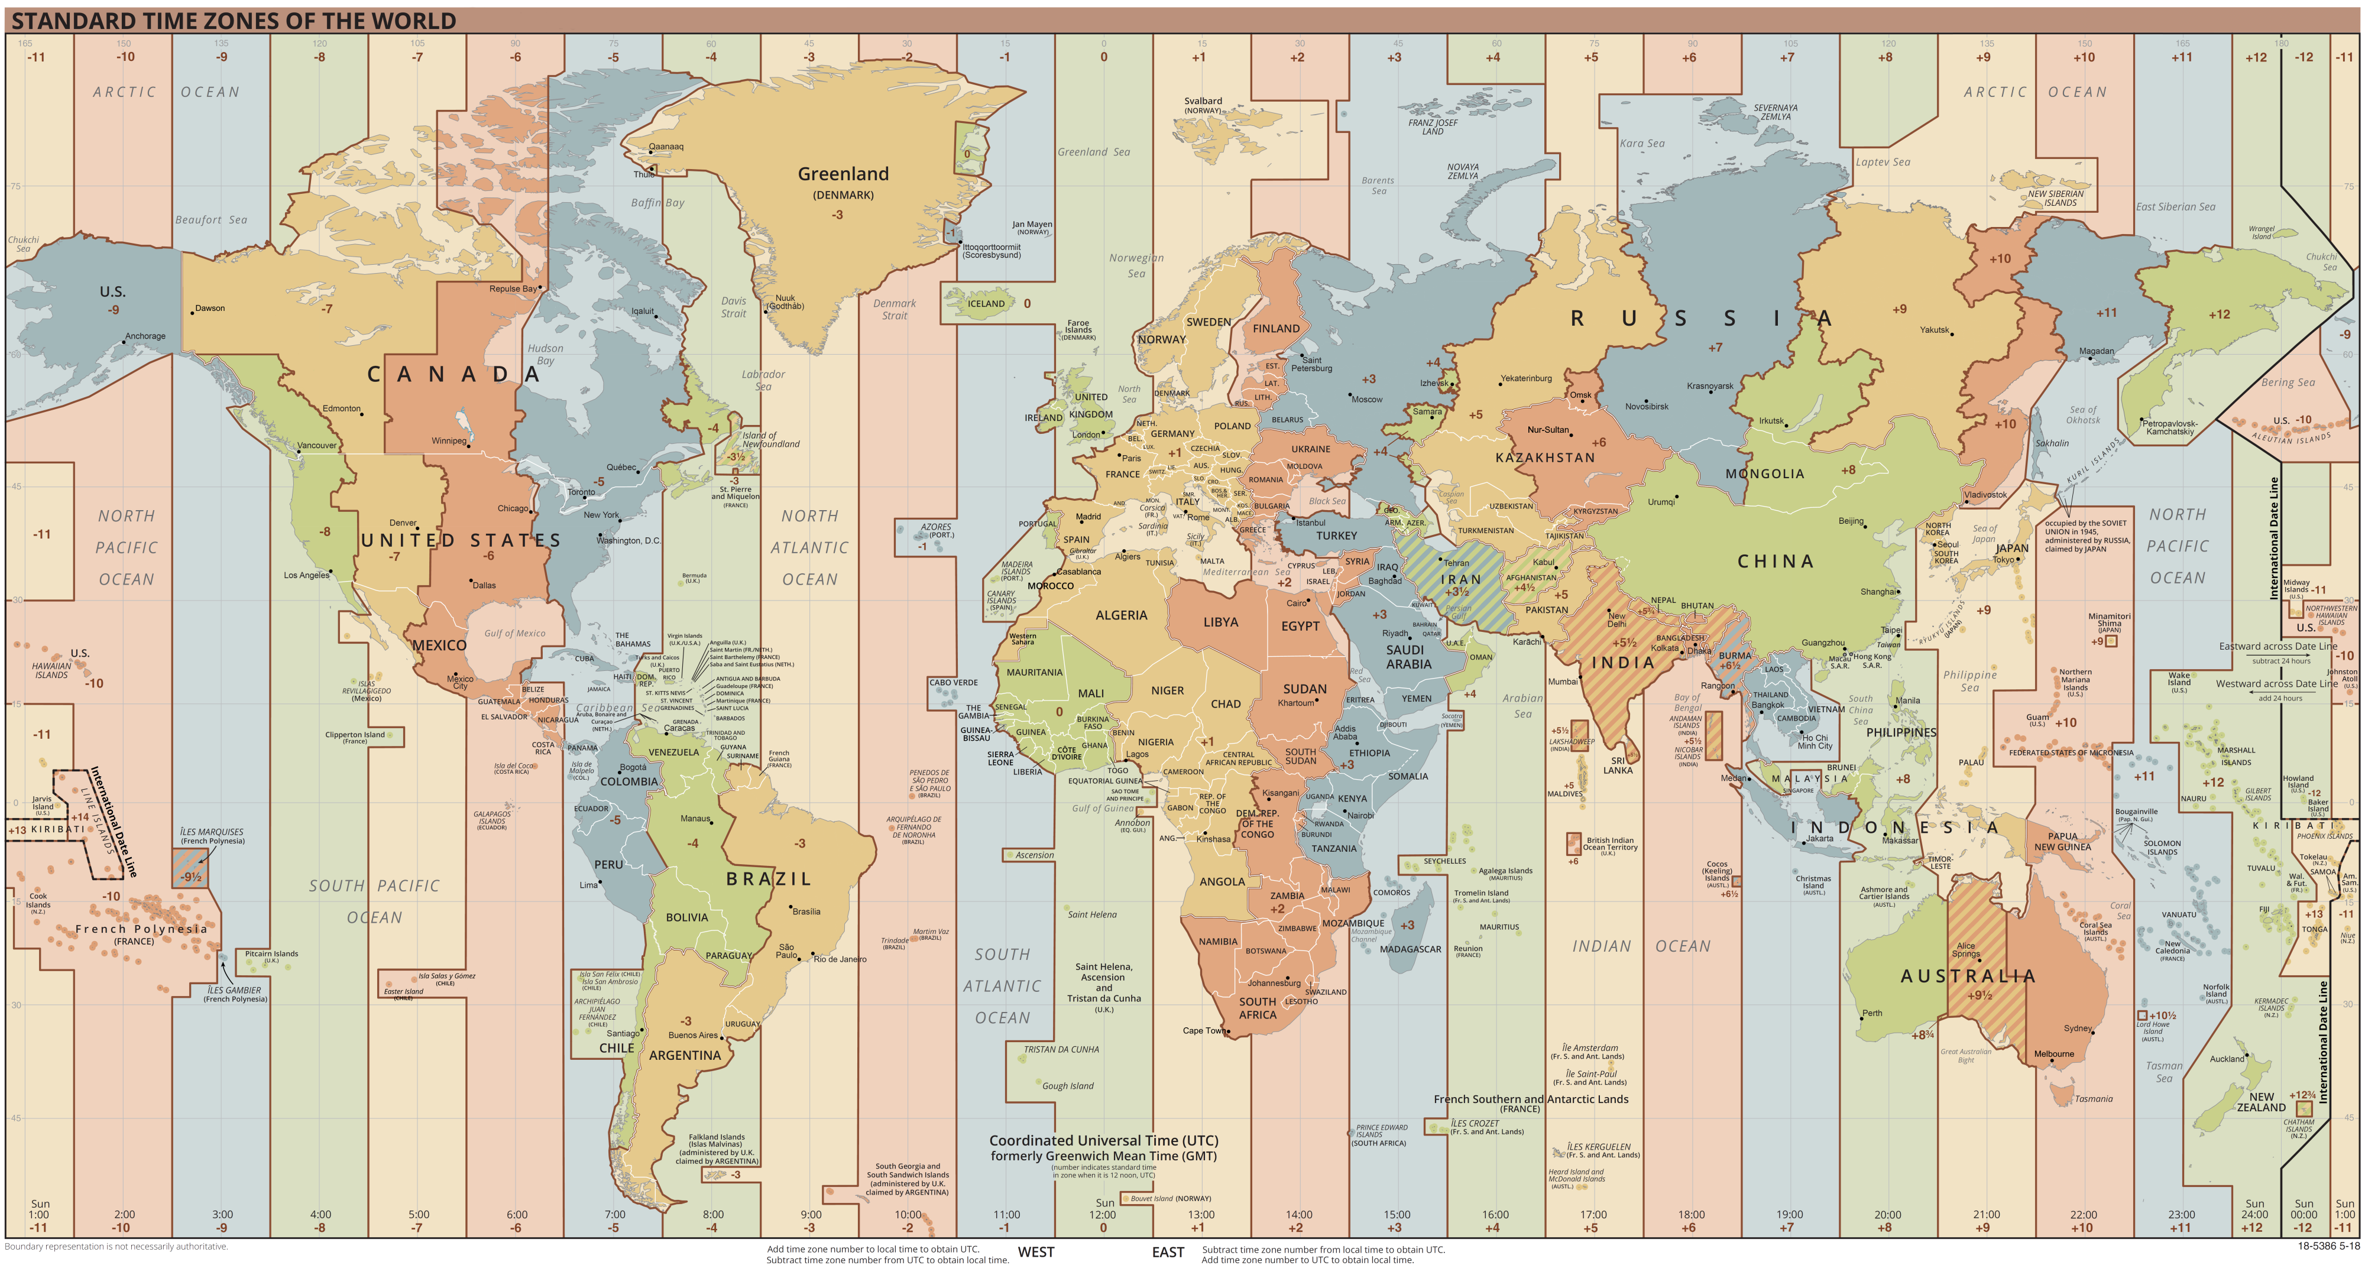
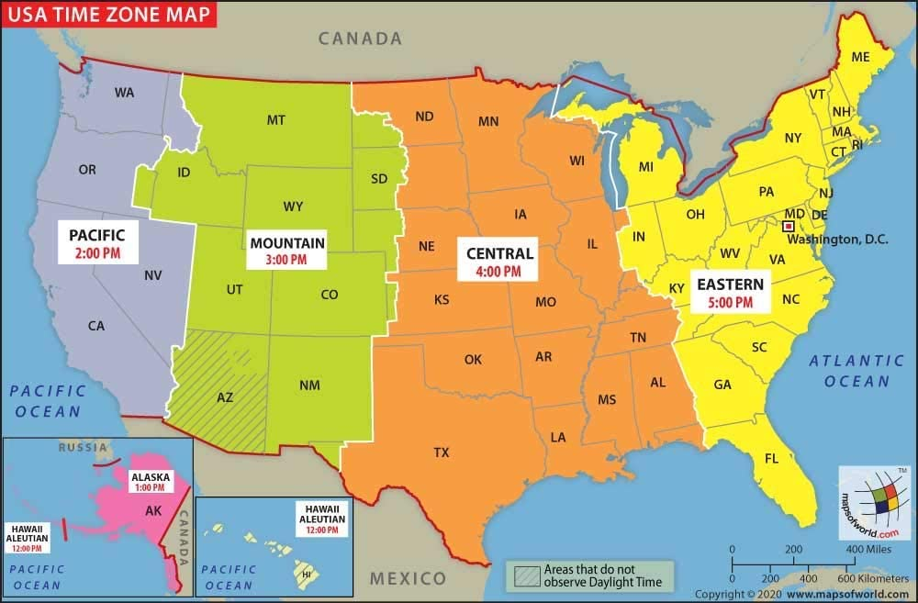
Keeping time
Mean Solar Time and Standard Time
Mean Solar Time, is based on the average value of the solar day over the course of the year.
A mean solar day contains exactly 24 hours
Mean solar time has the advantage of progressing at a uniform rate, but it is inconvenient for practical use because it is determined by the position of the Sun.
For example, noon occurs when the Sun is highest in the sky on the meridian (but not necessarily at the zenith). But because we live on a round Earth, the exact time of noon is different as you change your longitude by moving east or west.
Standard time, the system of 24 standardized global time zones.
In 1883, the United States was divided into four standard time zones (now six, including Hawaii and Alaska), each with one system of time within that zone.
Now travelers reset their watches only when the time change has amounted to a full hour.

Slide 16
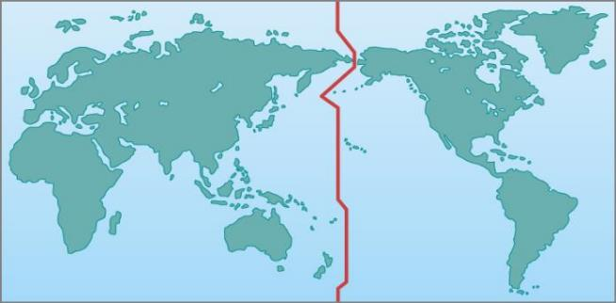
The international date line
The fact that time is always advancing as you move toward the east presents a problem. Suppose you travel eastward around the world. You pass into a new time zone, on the average, about every 15° of longitude you travel, and each time you dutifully set your watch ahead an hour. By the time you have completed your trip, you have set your watch ahead a full 24 hours and thus gained a day over those who stayed at home. The International Date Line is set by international agreement to run approximately along the 180° meridian of longitude. The date line runs down the middle of the Pacific Ocean, although it jogs a bit in a few places to avoid cutting through groups of islands and through Alaska. By convention, at the date line, the date of the calendar is changed by one day. Crossing the date line from west to east, thus advancing your time, you compensate by decreasing the date; crossing from east to west, you increase the date by one day. To maintain our planet on a rational system of timekeeping, we simply must accept that the date will differ in different cities at the same time.
Where the Date Changes. The International Date Line is an arbitrarily drawn line on Earth where the date changes. So that neighbors do not have different days, the line is located where Earth’s surface is mostly water.

Slide 17
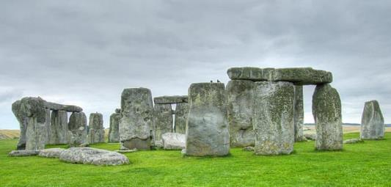
The Challenge of the calendar
There are two traditional functions of any calendar.
Frist, it must keep track of time over the course of long spans, allowing people to anticipate the cycle of the seasons and to honor special religious or personal anniversaries.
Second, to be useful to a large number of people, a calendar must use natural time intervals that everyone can agree on—those defined by the motions of Earth, the Moon, and sometimes even the planets.
The natural units of our calendar are the day, based on the period of rotation of Earth; the month, based on the cycle of the Moon’s phases about Earth; and the year, based on the period of revolution of Earth about the Sun.
Stonehenge. The ancient monument known as Stonehenge was used to keep track of the motions of the Sun and Moon. 2800 to 1500 BCE. (credit: modification of work by Adriano Aurelio Araujo)
The rotation period of Earth is, by definition, 1.0000 day (and here the solar day is used, since that is the basis of human experience).
The period required by the Moon to complete its cycle of phases, called the month, is 29.5306 days. The basic period of revolution of Earth, called the tropical year, is 365.2422 days.
The ratios of these numbers are not convenient for calculations. This is the historic challenge of the calendar, dealt with in various ways by different cultures.

Slide 18
Chapter 4
EARTH, MOON, AND SKY
4.1 Earth and Sky
4.2 The Seasons
4.3 Keeping Time
4.4 The Calendar
4.5 Phases and Motions of the Moon
4.6 Ocean Tides and the Moon
4.7 Eclipses of the Sun and Moon
By the end of these sections, you will be able to:
Explain the cause of the lunar phases
Understand how the Moon rotates and revolves around Earth
Describe what causes tides on Earth
Explain why the amplitude of tides changes during the course of a month
Describe what causes lunar and solar eclipses
Differentiate between a total and partial solar eclipse
Explain why lunar eclipses are much more common than solar eclipses

Slide 19
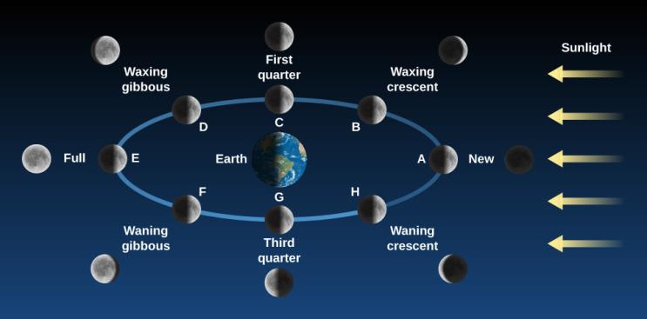
Lunar phases
After the Sun, the Moon is the brightest and most obvious object in the sky. Unlike the Sun, it does not shine under its own power, but merely glows with reflected sunlight.
As we watch the Moon from our vantage point on Earth, how much of its face we see illuminated by sunlight depends on the angle the Sun makes with the Moon.
In every position in the figure, the Moon is half illuminated and half. The difference at each position has to do with what part of the Moon faces Earth.
Phases of the Moon. The appearance of the Moon changes over the course of a complete monthly cycle. The pictures of the Moon on the white circle show the perspective from space, with the Sun off to the right in a fixed position. The outer images show how the Moon appears to you in the sky from each point in the orbit. Imagine yourself standing on Earth, facing the Moon at each stage. In the position “New,” for example, you are facing the Moon from the right side of Earth in the middle of the day. (Note that the distance of the Moon from Earth is not to scale in this diagram: the Moon is roughly 30 Earth-diameters away from us.) (credit: modification of work by NASA)
The Moon is said to be new when it is in the same general direction in the sky as the Sun (position A). Here, its bright side is turned away from us and its dark side is turned toward us. In this phase, the Moon is invisible to us; its dark, rocky surface does not give off any light of its own. Because the new moon is in the same part of the sky as the Sun, it rises at sunrise and sets at sunset.

Slide 20
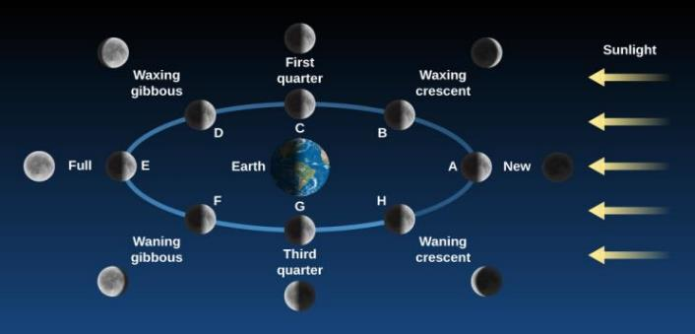
Lunar phases
Since it takes about 30 days to orbit Earth and there are 360° in a circle, the Moon will move about 12° in the sky each day (or about 24 times its own diameter).
A day or two after the new phase, the thin crescent first appears, as we begin to see a small part of the Moon’s illuminated hemisphere.
It has moved into a position where it now reflects a little sunlight toward us along one side.
The bright crescent increases in size on successive days as the Moon moves farther and farther around the sky away from the direction of the Sun (position B).
Because the Moon is moving eastward away from the Sun, it rises later and later each day.
After about one week, the Moon is one-quarter of the way around its orbit (position C) and so we say it is at the first quarter phase.
We see more of the Moon’s illuminated hemisphere (position D), a phase that is called waxing (or growing) gibbous (from the Latin gibbus, meaning hump). Eventually, the Moon arrives at position E in our figure, where it and the Sun are opposite each other in the sky. The side of the Moon turned toward the Sun is also turned toward Earth, and we have the full phase.
The Moon does the opposite of what the Sun does, rising at sunset and setting at sunrise.
The Moon goes through the same phases again in reverse order returning to new phase after about 29.5 days.

Slide 21
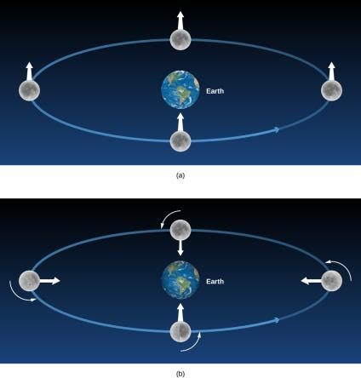
The Moon’s Revolution and Rotation
The Moon’s sidereal period—that is, the period of its revolution about Earth measured with respect to the stars—is a little over 27 days: the sidereal month is 27.3217 days to be exact.
The time interval in which the phases repeat—say, from full to full—is the solar month, 29.5306 days.
The difference results from Earth’s motion around the Sun. The Moon must make more than a complete turn around the moving Earth to get back to the same phase with respect to the Sun.
The delay in moonrise from one day to the next caused by this eastward motion averages about 50 minutes.
The Moon rotates on its axis in exactly the same time that it takes to revolve about Earth. As a consequence, the Moon always keeps the same face turned toward Earth
Also called Synchronous Rotation or
Tidal Locking
The Moon without and with Rotation. In this figure, we stuck a white arrow into a fixed point on the Moon to keep track of its sides.
If the Moon did not rotate as it orbited Earth, it would present all of its sides to our view; hence the white arrow would point directly toward Earth only in the bottom position on the diagram.
Actually, the Moon rotates in the same period that it revolves, so we always see the same side (the white arrow keeps pointing to Earth).

Slide 22
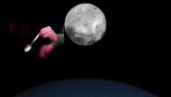

Slide 23
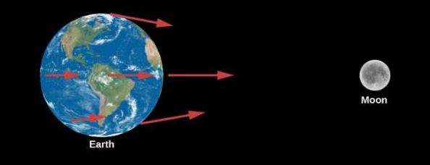
Ocean Tides and the Moon
The gravitational forces exerted by the Moon at several points on Earth are illustrated in the figure.
These forces differ slightly from one another because Earth is not a point but has a certain size: all parts are not equally distant from the Moon, nor are they all in exactly the same direction from the Moon.
Moreover, Earth is not perfectly rigid. As a result, the differences among the forces of the Moon’s attraction on different parts of Earth (called differential forces) cause Earth to distort slightly.
Pull of the Moon. The Moon’s differential attraction is shown on different parts of Earth. (Note that the differences have been exaggerated for educational purposes.)
The side of Earth nearest the Moon is attracted toward the Moon more strongly than is the center of Earth, which in turn is attracted more strongly than is the side opposite the Moon. Thus, the differential forces tend to stretch Earth slightly into an oblate spheroid (which is something like an American football shape), with its long diameter pointed toward the Moon.
Because the tidal distortion of the solid Earth amounts—at its greatest—to only about 20 centimeters, Earth does not distort enough to balance the Moon’s differential forces with its own gravity. Hence, objects at Earth’s surface experience tiny horizontal tugs, tending to make them slide about. These tide-raising forces are too insignificant to affect solid objects like astronomy students or rocks in Earth’s crust, but they do affect the waters in the oceans.

Slide 24
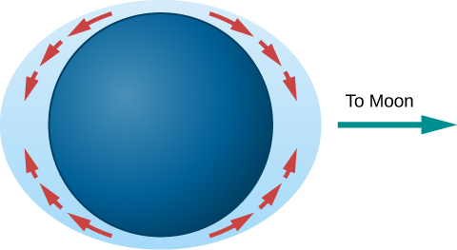
The Formation of Tides
The tide-raising forces, acting over a number of hours, produce motions of the water that result in measurable tidal bulges in the oceans.
Water on the side of Earth facing the Moon flows toward it, with the greatest depths roughly at the point below the Moon. On the side of Earth opposite the Moon, water also flows to produce a tidal bulge.
Tidal Bulges in an “Ideal” Ocean. Differences in gravity cause tidal forces that push water in the direction of tidal bulges on Earth.

Slide 25
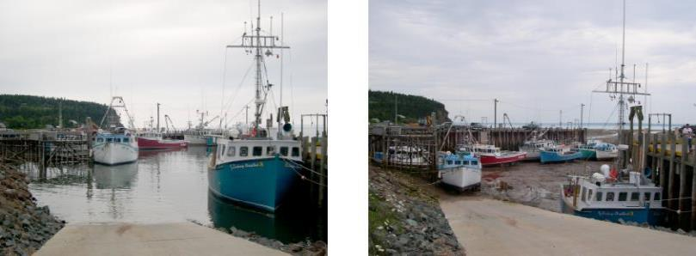
The Formation of Tides
High and Low Tides. This is a side-by-side comparison of the Bay of Fundy in Canada at high and low tides. (credit a, b: modification of work by Dylan Kereluk)
Note that the tidal bulges in the oceans do not result from the Moon’s compressing or expanding the water, nor from the Moon’s lifting the water “away from Earth.” Rather, they result from an actual flow of water over Earth’s surface toward the two regions below and opposite the Moon, causing the water to pile up to greater depths at those places.

Slide 26
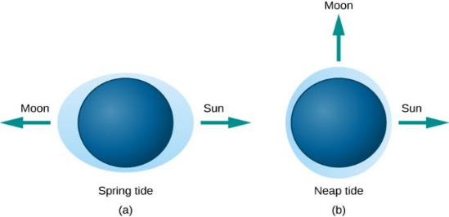
The Formation of Tides
The Sun also produces tides on Earth, although it is less than half as effective as the Moon at tide raising. The actual tides we experience are a combination of the larger effect of the Moon and the smaller effect of the Sun. When the Sun and Moon are lined up (at new moon or full moon), the tides produced reinforce each other and so are greater than normal. These are called spring tides (the name is connected not to the season but to the idea that higher tides “spring up”).
Spring tides are approximately the same, whether the Sun and Moon are on the same or opposite sides of Earth, because tidal bulges occur on both sides.
Tides Caused by Different Alignments of the Sun and Moon.
In spring tides, the Sun’s and Moon’s pulls reinforce each other.
In neap tides, the Sun and the Moon pull at right angles to each other, and the resulting tides are lower than usual.
When the Moon is at first quarter or last quarter (at right angles to the Sun’s direction), the tides produced by the Sun partially cancel the tides of the Moon, making them lower than usual. These are called neap tides.
The “simple” theory of tides, described in the preceding paragraphs, would be sufficient if Earth rotated very slowly and were completely surrounded by very deep oceans. However, the presence of land masses stopping the flow of water, the friction in the oceans and between oceans and the ocean floors, the rotation of Earth, the wind, the variable depth of the ocean, and other factors all complicate the picture.
This is why, in the real world, some places have very small tides while in other places huge tides become tourist attractions.

Slide 27
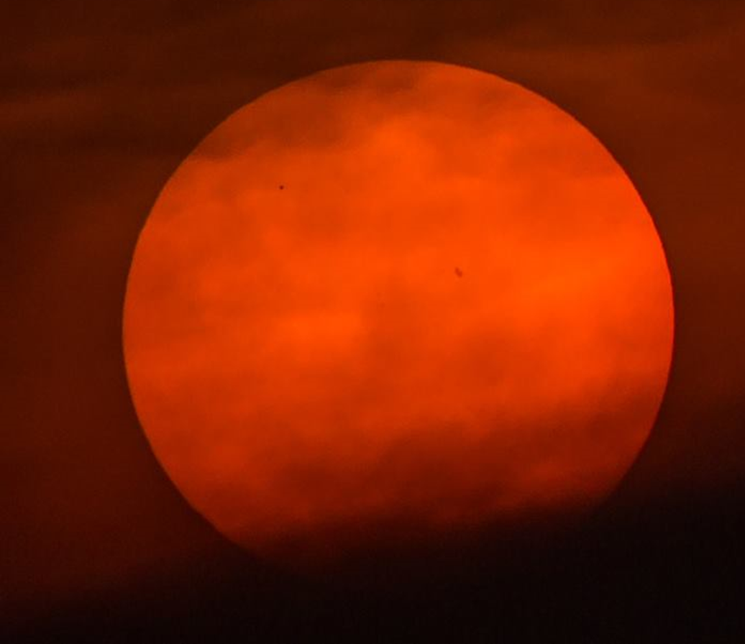
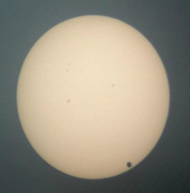
eclipses
Mercury
The Sun and the Moon, have nearly the same apparent size in the sky.
The Sun is about 400 times larger in diameter than the Moon, it is also about 400 times farther away.
Both the Sun and the Moon have the same angular size—about 1/2°.
As a result, the Moon, as seen from Earth, can appear to cover the Sun, producing one of the most impressive events in nature.
Last Mercury Transit was on May 9, 2016, and the next one will be on Nov. 13, 2032.
Last Venus Transit was on June 5,6, 2012; and the next one will be on Dec. 2117.
Venus

Slide 28
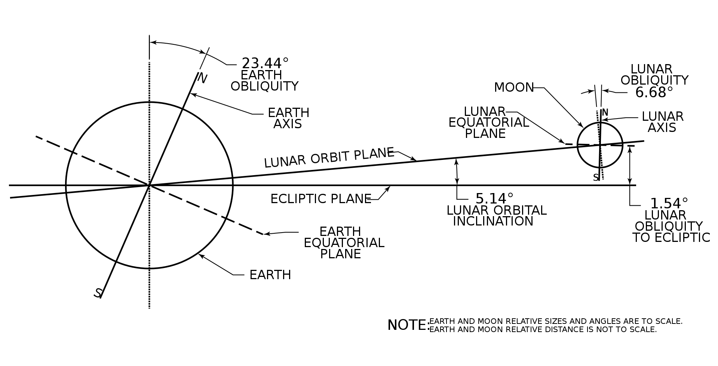
Geometry of Orbital Planes

Slide 29
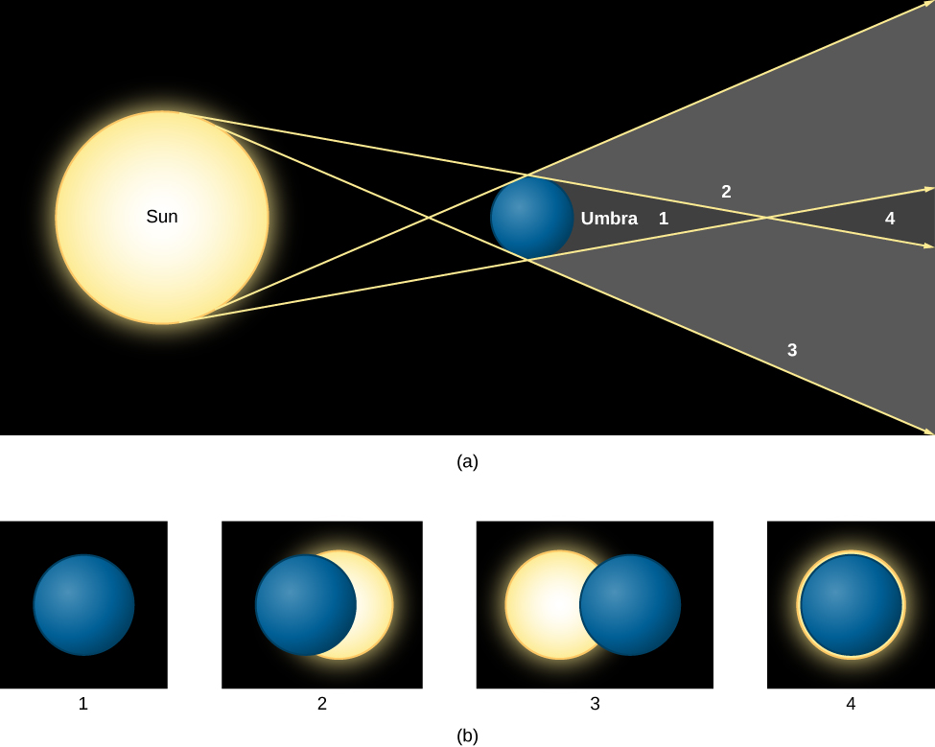
Solar eclipses
(a) The shadow cast by a spherical body (the Moon, for example) is shown. Notice the dark umbra and the lighter penumbra. Four points in the shadow are labeled with numbers.
(b) You see what the Sun and Moon would look like in the sky at the four labeled points. At position 1, you see a total eclipse. At positions 2 and 3, the eclipse is partial. At position 4, the Moon is farther away and thus cannot cover the Sun completely; a ring of light thus shows around the Sun, creating what is called an “annular” eclipse.
The Moon’s orbit is tilted relative to the plane of Earth’s orbit about the Sun by about 5°. As a result, during most months, the Moon is sufficiently above or below the ecliptic plane to avoid an eclipse.

Slide 30
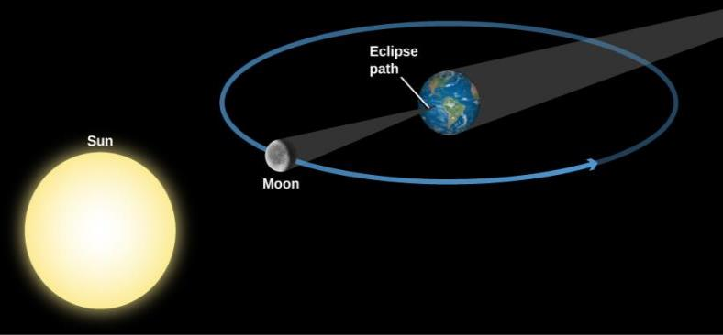
Geometry of a Total Solar Eclipse
If the Sun and Moon are properly aligned, then the Moon’s darkest shadow intersects the ground at a small point on Earth’s surface.
Anyone on Earth within the small area covered by the tip of the Moon’s shadow will, for a few minutes, be unable to see the Sun and will witness a total eclipse.
At the same time, observers on a larger area of Earth’s surface who are in the penumbra will see only a part of the Sun eclipsed by the Moon: we call this a partial solar eclipse.
Note that our diagram is not to scale. The Moon blocks the Sun during new moon phase as seen from some parts of Earth and casts a shadow on our planet.
The Moon’s shadow sweeps eastward at about 1500 kilometers per hour along a thin band across the surface of Earth – called Eclipse Path

Slide 31
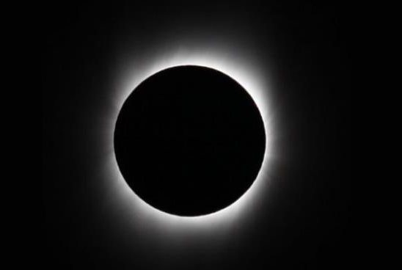
Total Eclipse
About an hour after the eclipse begins, the Sun becomes completely hidden behind the Moon.
In the few minutes immediately before this period of totality begins, the sky noticeably darkens, some flowers close up, and chickens may go to roost.
As an eerie twilight suddenly descends during the day, other animals (and people) may get disoriented.
During totality, the sky is dark enough that planets and stars become visible in the sky.
While the total eclipse are safe to look at, if any part of the Sun is uncovered, you must protect your eyes with safe eclipse glasses.
Maximum Duration 10 – 12 Minutes
The Sun’s Corona. The corona (thin outer atmosphere) of the Sun is visible during a total solar eclipse. (It looks more extensive in photographs than it would to the unaided eye.) (credit: modification of work by Lutfar Rahman Nirjhar)

Slide 32
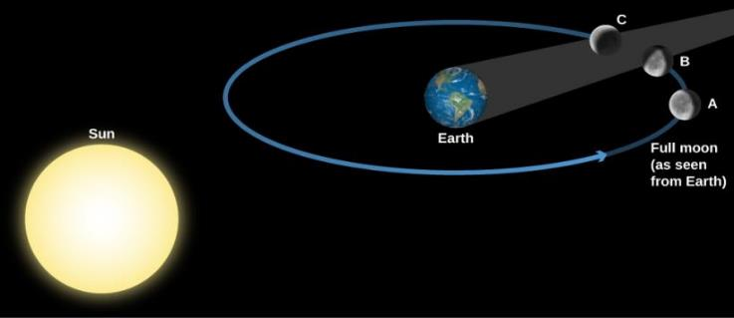
Geometry of a Lunar Eclipse
A Lunar Eclipse occurs when the Moon enters the shadow of Earth.
Earth’s dark shadow is about 1.4 million kilometers long, so at the Moon’s distance (an average of 384,000 kilometers), it could cover about four full moons.
Unlike a solar eclipse, which is visible only in certain local areas on Earth, a lunar eclipse is visible to everyone who can see the Moon.
The Moon is shown moving through the different parts of Earth’s shadow during a total lunar eclipse. Note that the distance the Moon moves in its orbit during the eclipse has been exaggerated here for clarity.
For an eclipse where the Moon goes through the center of Earth’s shadow, each partial phase consumes at least 1 hour, and totality can last as long as 1 hour and 40 minutes.
Since the lunar eclipse happens to a full moon, and a full moon is not dangerous to look at, everyone can look at the Moon during all the parts of the eclipse without worrying about safety.

Slide 33
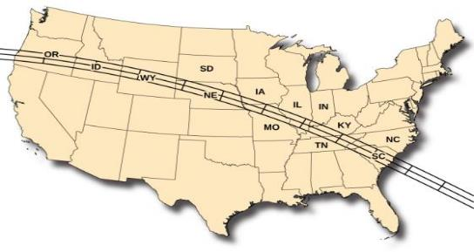
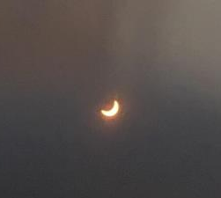
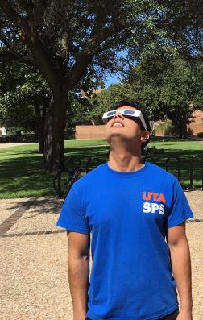
2017 Total Solar Eclipse
April 8, 2024
Total Solar Eclipse
N Mexico, U.S. (TX to ME)
May 16, 2022
Total Lunar Eclipse
N America, S America, Europe, Africa
This map of the United States shows the path of the total solar eclipse of 2017. On August 21, 2017, the shadow will first cross onto the West Coast near Portland, Oregon, traversing the United States and exiting the East Coast in South Carolina approximately 90 minutes later, covering about 3000 miles in the process. (credit: modification of work by NASA)

Slide 34
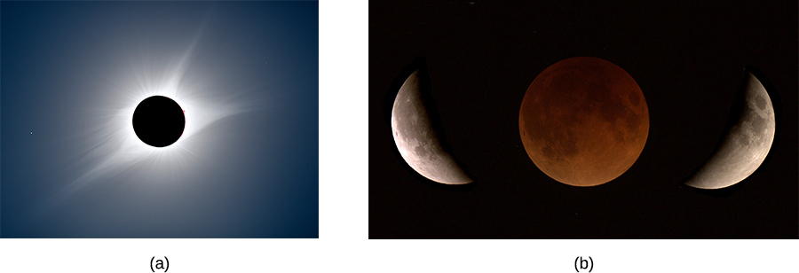
2017 Total Solar and 2018 Lunar Eclipse
The eclipsed Sun August 21, 2017, showing remarkable detail in the Sun’s outer atmosphere. This is a composite of short, medium, and long exposures, as no single exposure can capture the huge range of brightness the Sun exhibits.
A total eclipse of the Moon seen over California on January 31, 2018. The Moon moves slowly into the Earth’s shadow, looks red when the eclipse is total and red sunlight refracts through the Earth’s atmosphere, and then slowly moves out of the shadow. (credit a: modification of work by Rick Fienberg, American Astronomical Socity/TravelQuest International; credit b: modification of work by Brian Day.)

Slide 35
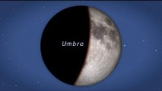

Slide 36
End of the chapter
This OpenStax ancillary resource is © Rice University under a CC-BY 4.0 International license; it may be reproduced or modified but must be attributed to OpenStax, Rice University and any changes must be noted.

